Slide 1

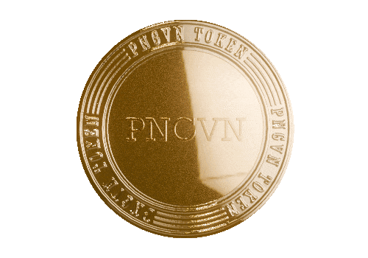

THE PNGVN COLLECTION
暗号ポートフォリオの自然な一部
www.pngvn.community Copyright © PNGVN ®
Notes:
"Hello everyone, and welcome!
I’m absolutely excited to share with you today the remarkable innovations that are revolutionizing the way we interact with the crypto world.
PNGVN stands at the forefront of this transformation, with a groundbreaking approach that is truly unmatched—many of our developments are the first of their kind globally.
Our systems are meticulously designed not just for sustainable long-term growth and stability but also for significant short-term financial gains.
Over the next few minutes, we will delve into how PNGVN is reshaping the crypto landscape and why incorporating PNGVN into your crypto portfolio isn't just a smart choice—it's essential for navigating the future of this dynamic market.
So, Let’s embark on this exciting journey together!"

Slide 2

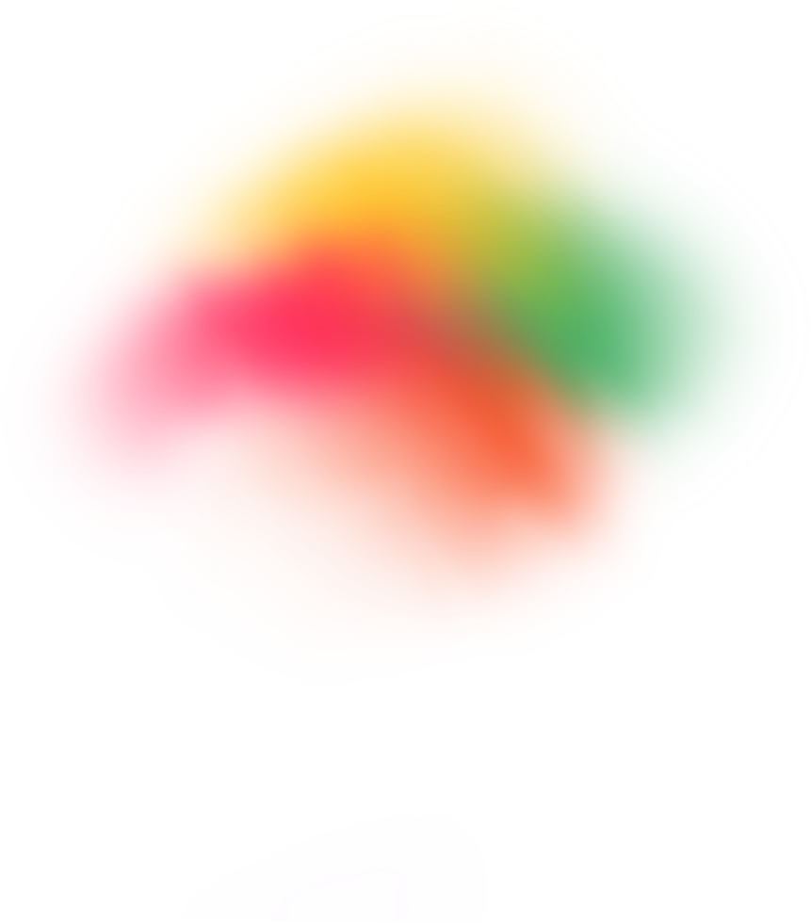

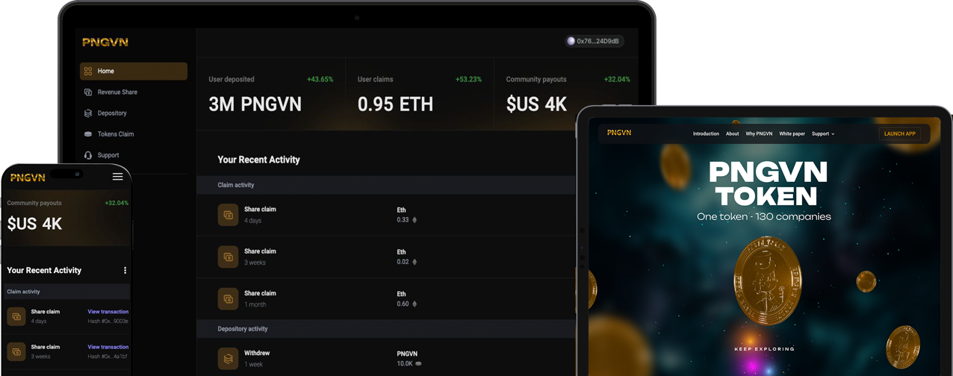
すべては数字の中に
長期的な暗号を構築する
私たちと一緒にポートフォリオを
ご存知でしたか？ 金融市場の70％近くがファンドとして構成されています。 しかし、暗号市場には一つもありません!!!
有望だが不安定な市場における多様化の重要性
Notes:
"The cryptocurrency market is notorious for its volatility, but within that very turbulence lies a treasure trove of incredible opportunities.
The secret to unlocking this potential is diversification, and that’s exactly what PNGVN delivers—a seamless way to build your long-term crypto portfolio with just ONE single token!
Did you realize that almost 70% of traditional financial markets are structured as funds, offering both diversification and stability?
Yet, the crypto space has been lacking this foundational support—until now!
PNGVN is poised to change the game, paving the way for a more stabilized and diversified approach to crypto investment that delivers financial gains every step of the way.
Embrace the future of finance with PNGVN and seize the opportunity to elevate your portfolio to new heights!"

Slide 3

すべては数字の中に
PNGVNトークン
暗号ランドスケープのポートフォリオビルダー：3つのカテゴリ - 80社 - 1つのトークン
トップ50 NFT
トップ15 暗号
トップ15 AI
市場シェア
この市場の時価総額の69.15％をカバー
投資資本の64％がこのセクターに
市場シェア
この市場の時価総額の86.51％をカバー
投資資本の18％がこのセクターに
市場シェア
この市場の時価総額の78.66％をカバー
投資資本の18％がこのセクターに
Notes:
"PNGVN is not just a token; it's your ultimate portfolio builder in the dynamic crypto landscape, encompassing three high-growth categories across an impressive 80 companies—all within a single token: the PNGVN token!
Structured and managed like an index fund, PNGVN offers unparalleled diversification across the booming sectors of NFTs, cryptocurrencies, and AI.
We have meticulously selected 80 of the top companies in these fields, granting you exposure to a vast array of cutting-edge technologies.
Our PNGVN index is equally weighted to mitigate risk and is actively managed by our seasoned experts.
With a focus on a larger market capitalization and an anticipated growth of 600% over the next 3-5 years, PNGVN presents a robust long-term investment solution.
Now, with just one simple token, you have the power to build a diverse portfolio across 80 innovative companies—no hassle, no complications, just straightforward growth. Invest in a better future with PNGVN!"

Slide 4




すべては数字の中に
PNGVNトークン
上場および監査済みのトークン
現在
上場
170,570,398 流通量
固定
Coinstoreに上場
$PNGVNとして取引
199,282,370
総供給量
Notes:
PNGVN token is a listed and fully security audited token
We currently have over 170 Million tokens in circulation and a total supply of just over 199 million tokens and we are listed on CoinStore

Slide 5

すべては数字の中に
PNGVNトークン
サクセスストーリー
ユーザー
売上高
6,924 2025年1月1日
$ 7,231,550 2025年1月1日
Notes:
"The PNGVN token is a continuing success story, and the numbers speak for themselves! Since our launch in March 2023, we’ve seen consistent growth, boasting nearly 7,000 users and a remarkable turnover of over $7.2 million as of January 1st, 2025.
These impressive results highlight the strength and potential of the PNGVN ecosystem, setting the stage for incredible momentum ahead.
Now is the time to join us—be a vital part of the next phase of growth in the PNGVN community!
Don’t miss out on this opportunity to secure your place in our exciting journey towards unprecedented success. And Get involved today!"

Slide 6
すべては数字の中に
PNGVN2トークン
上場予定
現在
ライブ
11,235,265 流通量 2025年2月1日
2024年10月15日より ブロックチェーン上でライブ
いつ上場されますか
PNGVNが30,000に達すると
ステーキング：1年5％の追加トークン
2年20％の追加トークン
250,000,000
総供給量
固定
進行中
Notes:
"And we’re just getting started!
We are thrilled to unveil PNGVN2, your next opportunity to capitalize on our success.
Currently live on the Blockchain, PNGVN 2's upcoming listing promises even greater avenues for growth, especially for early members who engage in staking.
With our staking incentives, members can earn additional tokens at no extra cost while enjoying lucrative dividend payouts once PNGVN2 is listed.
This is your chance to elevate your investment strategy—join us and seize the extraordinary potential of PNGVN2 today!"

Slide 7
すべては数字の中に
トリプル効果
独自の複利モデル
600%
市場成長
資本注入
毎月
配当支払い
四半期ごと
Notes:
"Our success is fueled by our groundbreaking triple-effect compounding model, which sets us apart from any other pre or existing fund in the market.
This innovative approach doesn’t just make our fund unique; it ensures its security and resilience for the long haul.
With robust monthly capital injections, enticing quarterly dividend payouts, and an astounding projected market growth of 600% within the next 3-5 years, we're not merely talking about passive growth—we're actively forging pathways to wealth through a dynamic, compounding strategy that is truly the first of its kind on the Blockchain.
You can monitor the PNGVN index in real-time on our cutting-edge Blockchain Asset Management platform, offering transparency like never before. We are pioneers in this arena, being the first company in the world to implement such a forward-thinking system on the blockchain.
Join us and be part of a financial revolution—where innovation meets opportunity!"

Slide 8

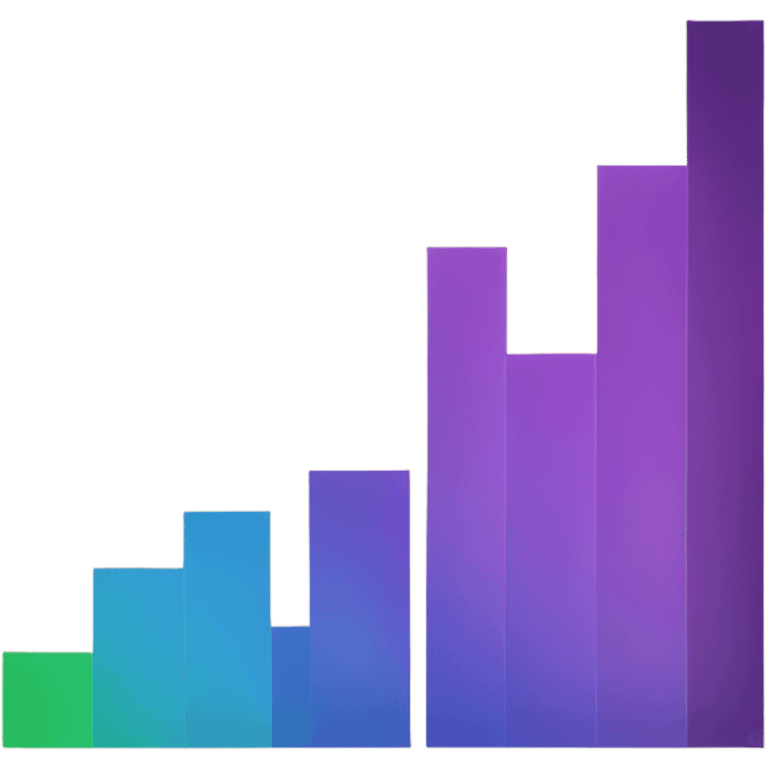


すべては数字の中に
トリプル効果
PNGVNトークンの固定供給
+
+
600%
予想成長率
3〜5年
資本注入
PNGVN売上高の25％
配当支払い
PNGVN売上高の20％
Notes:
"A cornerstone of our model is the fixed supply of PNGVN tokens. This limited availability is a powerful driver of the token's inherent value, effectively shielding it against inflation and ensuring that your investment maintains its worth amidst a rapidly rising market.
In addition, we are injecting fresh capital at a remarkable 25% of PNGVN's turnover, combined with a substantial further 20% of PNGVN community turnover allocated as dividends to our token holders.
This triple effect creates a robust and sustainable long-term strategy, one that is not only effective but can be consistently replicated as our vibrant community continues to expand.
Choose PNGVN and experience a dynamic investment model that promises not only security but also the potential for remarkable growth in an ever-evolving marketplace."

Slide 9

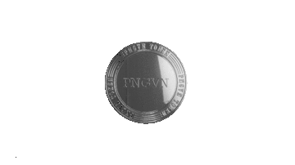





すべては数字の中に
トリプル効果
月間わずか10,000人のユーザーで
$0.50
2025年10月
$0.50
2026年10月
配当 支払い
PNGVN 売上高の20％
600%
予想成長率
3〜5年
$5.01
2026年10月
$8.62
2027年10月
$15.60
2027年10月
$27.01
2028年10月
$35.66
2028年10月
$43.12
2029年10月
$???
2029年10月
$???
2030年10月
資本 注入
PNGVN売上高の25％
Notes:
"The power of the triple effect is even more evident when considering that these projections are based on just 10,000 monthly members.
Imagine the potential for exponential growth as our community expands even further because it’s all in the numbers and the numbers are in our favour."

Slide 10
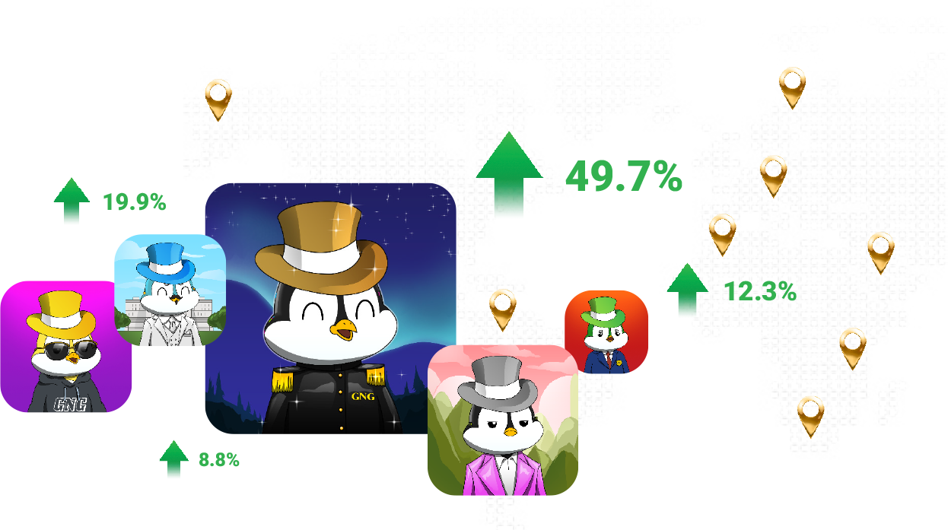

すべては数字の中に
資本源 PNGVNコミュニティ
当社の製品
ブランド構築NFT
95% 売上高はコミュニティに還元されます
Notes:
"The driving force behind our capital is the PNGVN Community—where every member plays a vital role in our collective success.
Our groundbreaking brand-building NFTs are not just functional; they are the first of their kind to cultivate a vibrant ecosystem.
An astonishing 95% of our turnover is reinvested directly into the hands of those who buy and hold our NFTs, a model never seen before that significantly enhances their value.
Unlike other NFT projects that rely on speculation, PNGVN’s success is grounded in a thriving community that champions loyalty and sustainability.
We provide a revolutionary product that empowers you to enter, earn, and grow your assets in the dynamic crypto space.
This is the essence of collaborative growth!
Our community-focused approach guarantees that the fruits of our success are shared among all members and holders of the PNGVN token.
Join us in this transformative movement and experience the power of true partnership in the world of NFTs!"

Slide 11
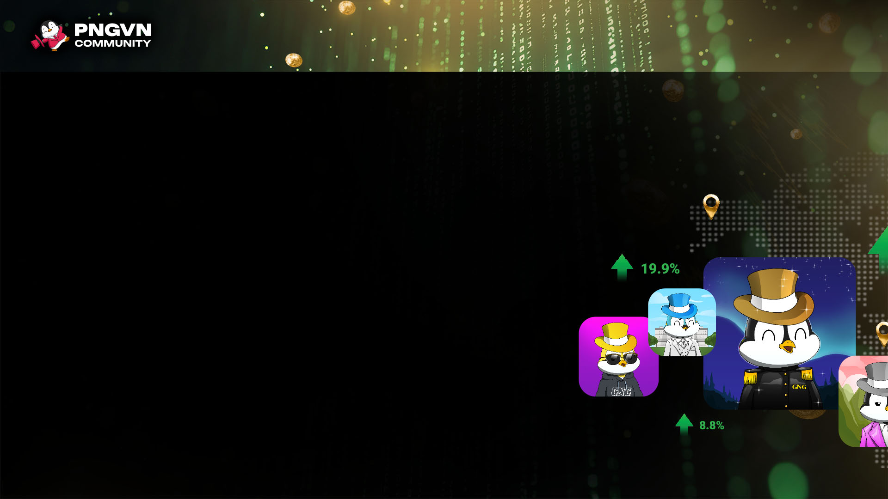





すべては数字の中に
製品ライン：PNGVN.community
イエローハット $200
100% PNGVN2
10% PNGVN
グリーンバンドル $400
105% PNGVN2
10% PNGVN
ブルーバンドル $900
100% PNGVN2 + 10%追加
10% PNGVN
シルバーバンドル $1,900
100% PNGVN2 + 15%追加
10% PNGVN
ゴールドバンドル $3,900
100% PNGVN2 + 20%追加
10% PNGVN
*すべての製品に4.5％の取引手数料が適用されます
Notes:
"We offer a range of attractive NFT’s to meet different levels and goals.
Each bundle provides a unique mix of PNGVN (our listed token) and PNGVN2 tokens, giving you real value from day 1, and offering diverse pathways to participation.
Our NFT product prices range from $200 to $3,900, making them globally accessible and affordable."

Slide 12

すべては数字の中に
バイナリープランで稼ぐ pngvn.community
レベル1：10％ レベル2：10％
レベル3：15％ レベル4：20％
すべての個人NFT販売で5％ のコミッションを獲得
ダウンラインのバイナリーマッチングボーナス（最大4レベル）の割合を獲得します。
7つのランクで4％のプールシェア
ペイレッグの週間ボリ ュームの10％を獲得
Notes:
"For those eager to amplify their returns, we present the most exhilarating binary plan in the market!
This dynamic opportunity allows you to earn additional income through referrals and team performance, igniting a powerful incentive to expand your network and your wealth!
Our binary plan is truly unparalleled, featuring an impressive 5% on personal sales, four levels of percentage earnings on our binary matching bonus, and a generous 10% on the pay leg—all paid out weekly, without exception!
We proudly offer a staggering 50% payout on our binary plan with no caps, constraints, or complicated qualifications.
Our rank requirements are straightforward and easy to navigate. As a ranked leader, you will have access to a massive 4% share of our total sales volume monthly, adding even more potential to your earnings.
Why do we offer such a massive payout compared to any other company in this space?
Because we believe that our success as a company is intrinsically linked to heavily rewarding our community for their efforts, ensuring they reap fantastic returns and great benefits.
Join our PNGVN community and connect with numerous successful six-figure earners who have already transformed their lives!
With a flawless record of 100% weekly payouts since our launch in March 2023, that’s over two years of consistent reward payouts and counting!
This is why our binary plan stands out as the most rewarding in the entire market, unlocking unlimited earning potential for everyone involved.
So, Get ready to embark on an extraordinary journey towards proven financial success with PNGVN!"

Slide 13
すべては数字の中に
暗号ポートフォリオを成長させる
誰かを招待するたびに、あなたは稼ぎ、資産を成長させます
すべての個人NFT販売で5%のコミッションを獲得
例 ゴールドバンドルで 誰かを招待する
$195
5%直接 紹介ボーナス
$390
PNGVN2トークンで 10%
PNGVN 2トークンで 10%獲得
Notes:
"The heart of our business model pulses with sustainability and long-term wealth creation, which is why we don’t just offer exceptional financial rewards for our community members.
We’re also unveiling an extraordinary opportunity for you to supercharge your crypto portfolio alongside us!
Imagine this: every time you invite someone to join our thriving community, you don’t just earn cash rewards—you also amplify your PNGVN token holdings!
This means that while you’re reaping immediate financial benefits, you’re simultaneously increasing your stake in the success of our ecosystem.
With greater PNGVN token holdings, you unlock an enhanced share of our dividend payouts and a larger slice of the index profit share.
As the market flourishes, so do you!
It’s a win-win situation—you earn, you grow, and you secure your future with the predictions of a booming crypto landscape.
Join us and transform your financial future, where your contributions lead directly to your prosperity.
Don’t miss out on this chance to elevate both your rewards and your crypto assets— and let’s thrive together!"

Slide 14

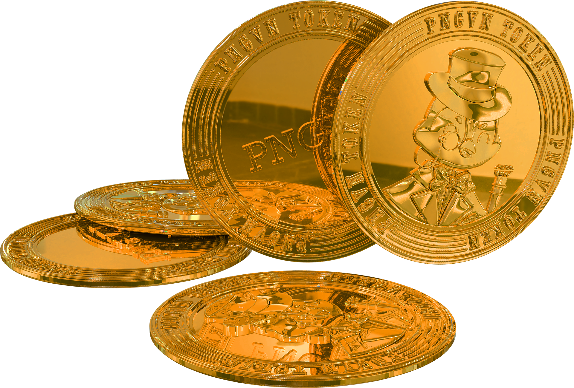
すべては数字の中に
暗号資産を構築する最も簡単な方法
PNGVNトークンを構築し、保有することです
機能的なブランド構築NFTを購入する
積極的に活動し、毎月NFTを購入する
誰かを招待して、トークンの価値の10%を受け取る
Notes:
It’ s never been easier to build your crypto assets than with building and holding PNGVN tokens
Three steps to thrive with the PNGVN ecosystem:
Read 1 to 3 above.
As well as all the other benefits shared in this presentation.

Slide 15

すべては数字の中に
NFT、WEB3、暗号通貨、デジタル資産、インデックスファンド、AI、現実世界の資産は、単なる流行語ではなく、私たちが生きている世界であり、常に進化しています。あなたはそれらとともに進化していますか？
PNGVNの価値は、デジタル進化をナビゲートするのに役立つように設計されています。
透明性 セキュリティ 自由
Notes:
”Remember, In today’s fast-paced world, NFTs, Web 3, cryptocurrency, digital assets, index funds, artificial intelligence, and real-world assets are not merely buzzwords—they represent the very fabric of our evolving landscape.
As we navigate this digital revolution, it’s essential to evolve alongside it, and PNGVN is here to guide you through these transformations.
We stand at the forefront of this digital evolution, leading the charge with our unwavering core values of transparency, security, and freedom.
These principles are embedded in every facet of our operations, driving our commitment to empowering our community and fostering trust in every interaction.
At PNGVN, we don’t just adapt to change; we embrace it, ensuring that you are equipped to thrive in this dynamic environment.
And now it’s your chance to join us as we journey into the future, where innovation meets integrity, and let’s unlock the full potential of the digital age together."

Slide 16

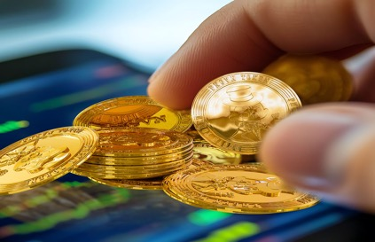
すべては数字の中に
資産管理の透明性完璧な戦略
将来の価値と成長のために設計
投資 25%
配当 20%
Notes:
"PNGVN delivers unparalleled transparency in asset management—this is what we call the Perfect Strategy!
We invest a powerful 25% of all revenue back into the PNGVN index, while 20% of all revenue is directly shared with our token holders through our innovative quarterly dividend payout strategy.
This dual approach is meticulously crafted to ensure future value and sustainable growth for our token holders!"

Slide 17
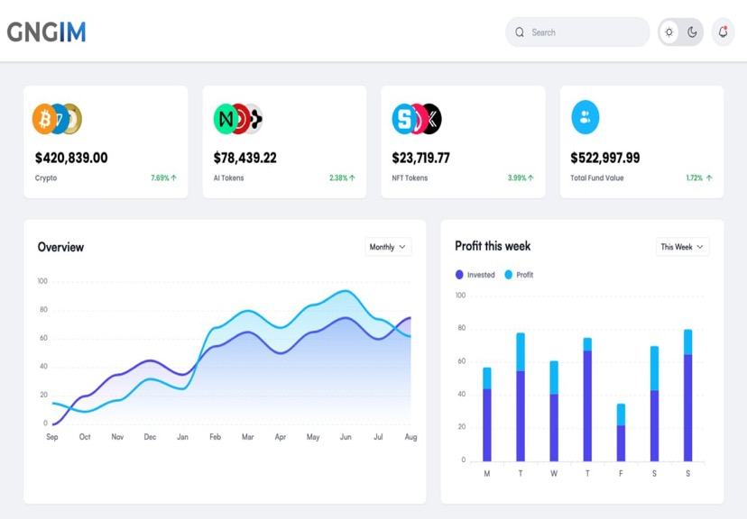



すべては数字の中に
B A Mのセキュリティ
年間10%の利益分配
DEXのPNGVNインデックス
70個のトークンとコイン
CEXのPNGVNインデックス
10個のトークンとコイン
Notes:
"Experience the unparalleled security of BAM—our cutting-edge Blockchain Assets Management system that rewards token holders with a remarkable annual 10% profit share!
Our advanced platform meticulously tracks, analyzes, and optimizes every investment for maximum returns.
At BAM, we're not just managing blockchain investments; we're pioneering them by creating innovative indexes across both decentralized and centralized platforms!"

Slide 18

すべては数字の中に
PNGVNアプリの自由
pngvntoken.com
2025年の配当支払い
1月24日
4月24日
7月24日
10月24日
重要な注意！
PNGVNトークンをロックアップして 3回の配当ラウンド（オプション）
*配当を受け取るには、これらの日付より前にPNGVNアプリの保管庫にPNGVNトークンを預ける必要があります
Notes:
"Unlock your freedom with the PNGVN app—your essential tool for managing tokens and claiming dividends!
Ensure your PNGVN tokens are securely deposited in the app depository to consistently enjoy quarterly dividends and reap the rewards for the long term!"

Slide 19

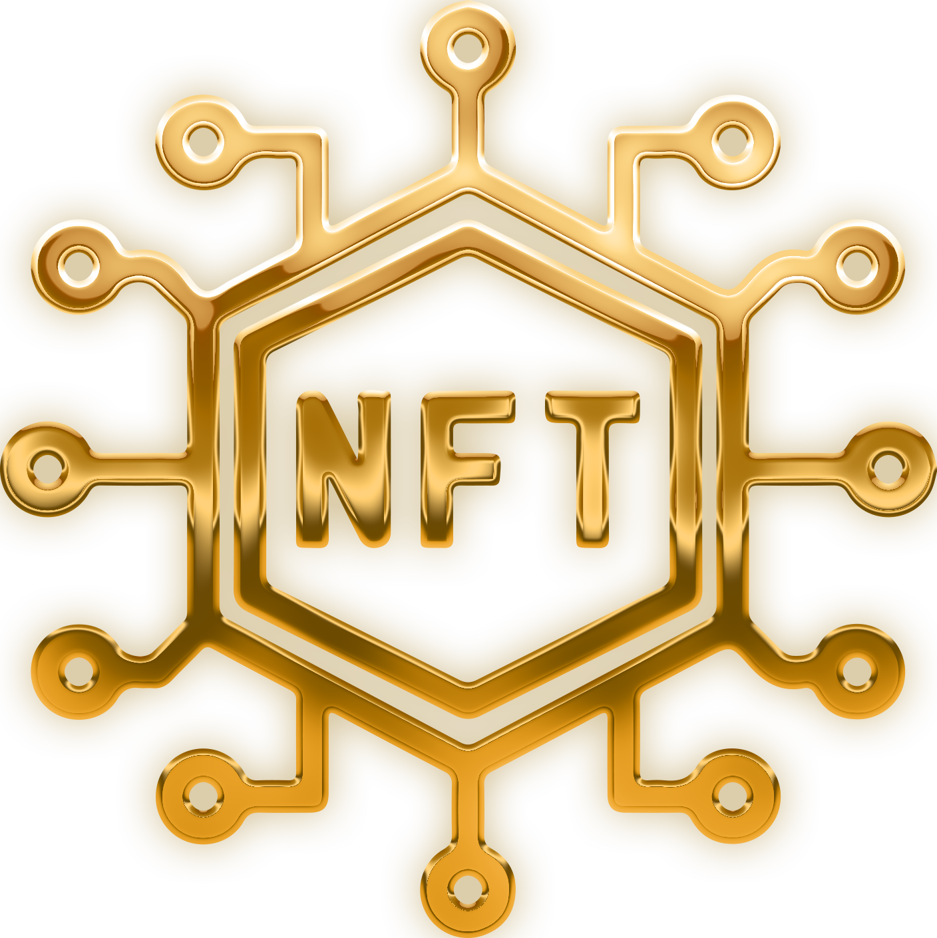






すべては数字の中に
概要
PNGVNファミリーに参加すると得られるもの
インデックス
投資の年間10%の利益分配
NFT
機能的なブランド構築NFTを受け取る
配当
ステーキングで四半期ごとに配当を受け取る
コミュニティ
PNGVNの活気に満ちた成長するコミュニティに参加する
PNGVN
のトークンを受け取る
NFTの価値
報酬 コミュニティの成長に対して50%の報酬が支払われる
Notes:
IN SUMMARY: "At PNGVN, we are not just symbols;
we offer you a complete ecosystem designed for your success!
When you join us, you not only receive a fantastic brand-building NFT but also become part of an ever-expanding PNGVN community that thrives on growth and collaboration.
You’ll be rewarded for your support with gifted PNGVN tokens that yield quarterly dividends, and as a proud holder, you’ll enjoy an annual 10% profit share from our thriving PNGVN index investments.
We unite the essential elements of the crypto space, community building, and financial growth into a seamless ecosystem that empowers you to earn and engage like never before.
Join PNGVN today and elevate your journey in the world of crypto—where opportunity meets collaboration and huge rewards await you at every turn!"

Slide 20
デジタル進化をリードする - 今すぐ始める
詳細については、こちらをご覧ください： www.pngvn.community
Notes:
"Thank you for your time!
Together, let’s pioneer the digital evolution and transform the future.
Don’t wait—take the first step now by accepting your personal invitation!
We eagerly await the opportunity to welcome you into the thriving PNGVN community, where excitement and opportunity await.
Join us today and be part of something extraordinary!"

